Slide 1
Literature Review on
Reducing Ambiguity in JSON Schema Discovery
By William Spoth, Oliver Kennedy Ying Lu, Beda Hammerschmidt, Zhen Hua Liu
Presented By
Somanshu Gupta, A20499077
Shubham Tiwari, A20499153
Pradeep Thapaliya, A20473870

Slide 2
Agenda
Introduction to JSON and JSON Schema
Problem in JSON Schema Discovery
JXPLAIN as a Solution to the Schema Discovery
Experiments & Results
Conclusion

Slide 3
Abstract
JSON data modeling connects several data sources into a single stream, and JSON flexibility depends on automated schema discovery approaches when writing data.
JXPLAIN, a JSON schema discovery technique with heuristics that develops a replica of frequent kinds of ambiguity and delivers considerably correct schemas, is developed.

Slide 4
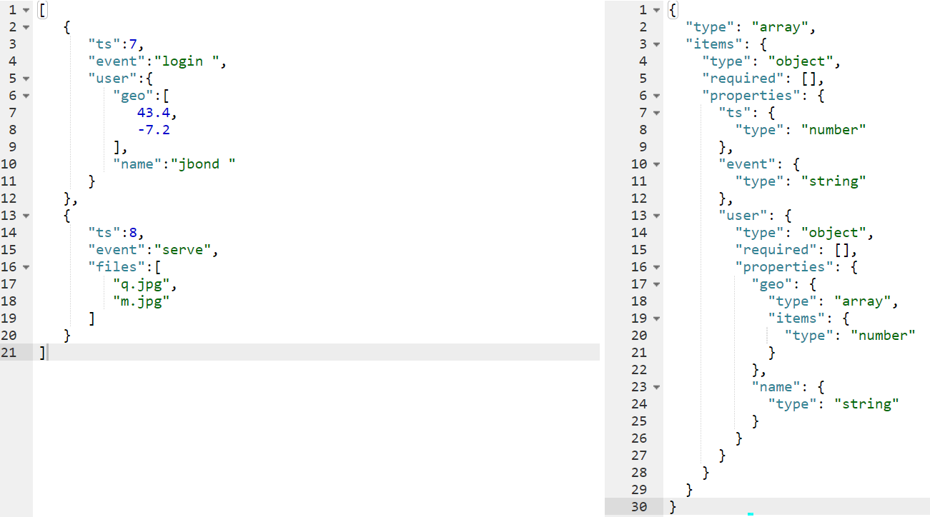
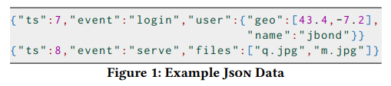
Big Picture
JSON Data
JSON Schema Generated using Online tools

Slide 5
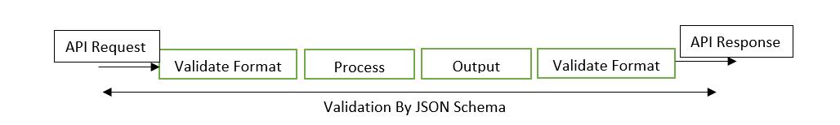
Introduction
JSON schema are JSON documents that describe other JSON documents. It is used to define the structure of a JSON message and validate it. Example: - API request and response in JSON format.
Primarily, JSON is used as the data exchange, information records as a database schema like Nosql databases such as mongodb, etc.

Slide 6
Background
The purpose is to re-create a hidden ground truth schema, which is a description of a set of acceptable JSON data based on a finite sampling of records taken from the set.
Notation:
Primitive values - String, number, boolean, and null
complex values - array or object

Slide 7
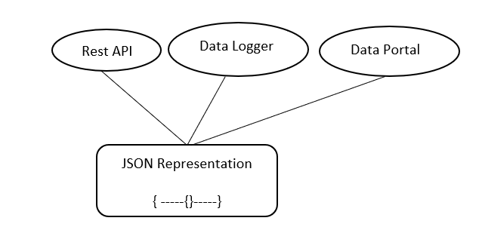
Applications use JSON for data representation
Types of System Approach:
1. Existing Schema Discovery Approach to Resolve Ambiguity.
2. JXPLAIN Assumption about the JSON.

Slide 8
Schema Discovery
1. Existing schema discovery techniques
They decide how to interpret a collection of records by the kind of the records in the collection like:
Arrays are always collection-like
Objects are always tuple-like
And collections always contain a single entity
But, Here it highlights the examples of Json in the wild that, that violate these assumptions, leading to imprecise schemas

Slide 9


2. JXPLAIN assumption about JSON
In the JXPLAIN it interpret a collection of records by the following.
Arrays as Tuple-Like Structure.
Objects as collections
Multi-Entity Collections
Rules to find Type
JSON Data
Naive Discovery
Notes:
modifinf the slides
after 8 slide

Slide 10
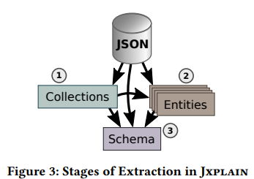
JXPLAIN - A System
It is a general framework for implementing ambiguous-aware schema discovery.
1. Parallelization - it decouples heuristics into separate computation stage
Pass ① invokes the is_collection heuristic to determine the set of paths at which a collection is present.
Pass ② adapts the partition heuristics to precompute a strategy for partitioning entities.
Pass ③ to synthesize the schema.
2. Sampling - it runs the discovery in only small set of training dataset and validates with respect to the test dataset. Following steps are the high level description of sampling steps
Derive a schema from a small sample of the training data
Validate the remainder of the training data
Add samples failing validation to the sample and repeat

Slide 11
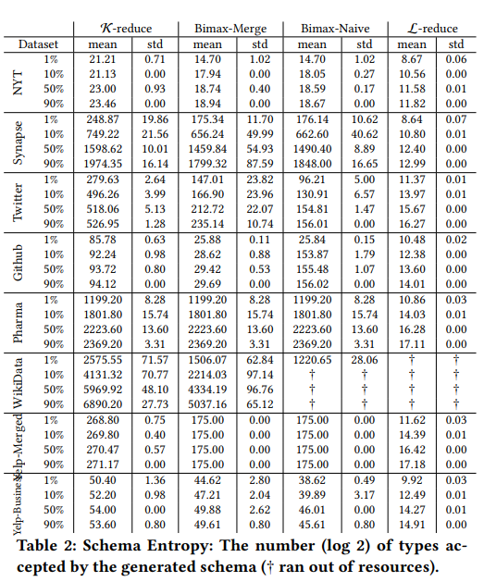
Ambiguity Matrices
Recall
Recall quantifies the number of positive class predictions made out of all positive examples in the dataset.
Entity Grouping
Number of entities output within a schema (partitioned)
Schema Entropy
Schema entropy is computed by treating each optional path as a binary decision, taking into account mandatory and locally mandatory paths

Slide 12
Ambiguous Schema Extraction
Interpreting collection of records by the kind of records in the collection are decided by schema discovery techniques. Collections always contain a single entity.
Collection Type: - Array
Tuple Type: - Objects
Multi collection entity

Slide 13
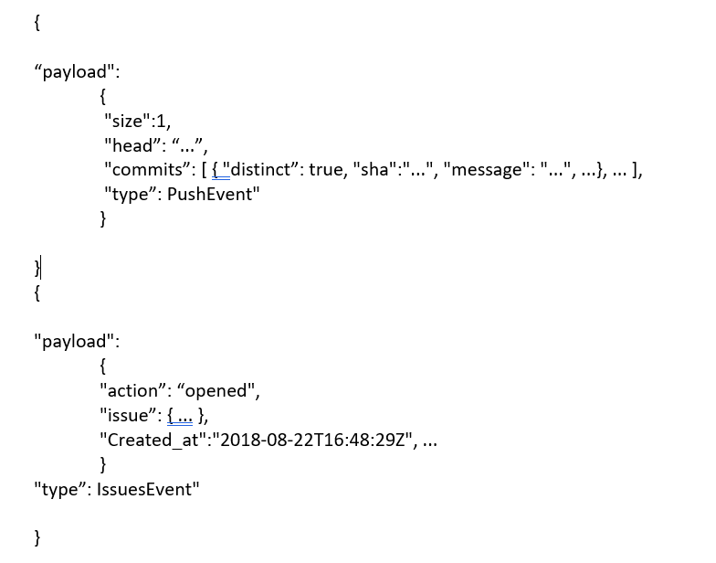
Arrays:
Example geo field encoded as an array, as fields coordinates are 2-element tuple and not a collection of numbers
{
“ts”: 7,
“event”: “login”,
“user”: {“geo”: [43.4, -7.2], “name”: “jbond”}
}
2. Objects as collection:
Maps keys (drugs) to values (prescription counts), field is a nested collection. Example: - {“cms_prescription_counts": {"DOXAZOSIN MESYLATE": 26, "MIDODRINE HCL": 12, ...}, ...}
3. Multi Entity Collection
Log data and event-based web APIs are often composite streams of multiple data types.
EXAMPLES

Slide 14
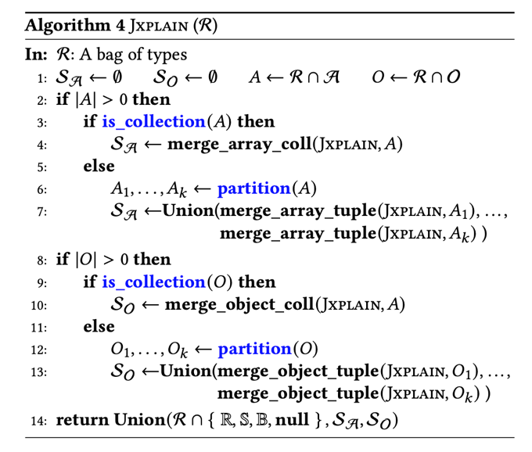
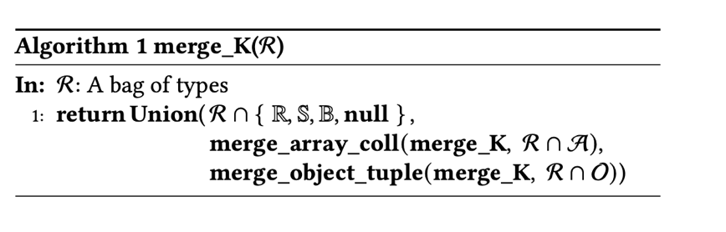
Algorithms
K-reduction:-
Array kinded types are interpreted as single-entity collections and object kinded types are always interpreted as tuples.
It is implemented through helper functions and have parameter recursive merge heuristic, k-reduction.
K-reduction distributivity: - merge_K (R1 U R2) = merge_K(merge_K(R1) U merge_K(R2)).
2. JXPLAIN Merge:-
Algorithm makes two decisions: -
Does a bag of array- or object-kinded types encode a collection or a tuple?
Given a bag of tuples, are there multiple entities represented in the bag?

Slide 15
Experiments & Claims
JXPLAIN produces schemas that are significantly more precise (i.e., admit fewer types) than K-reduction, while not incorrectly rejecting types that are legitimately part of the schema,
A clustering strategy based on Bimax bi-clustering is preferable to a standard technique like k-means.
The merge step described in Section 6 is critical for creating compact schemas, and
The overhead of the additional steps required by Jxplain is not prohibitive.

Slide 16
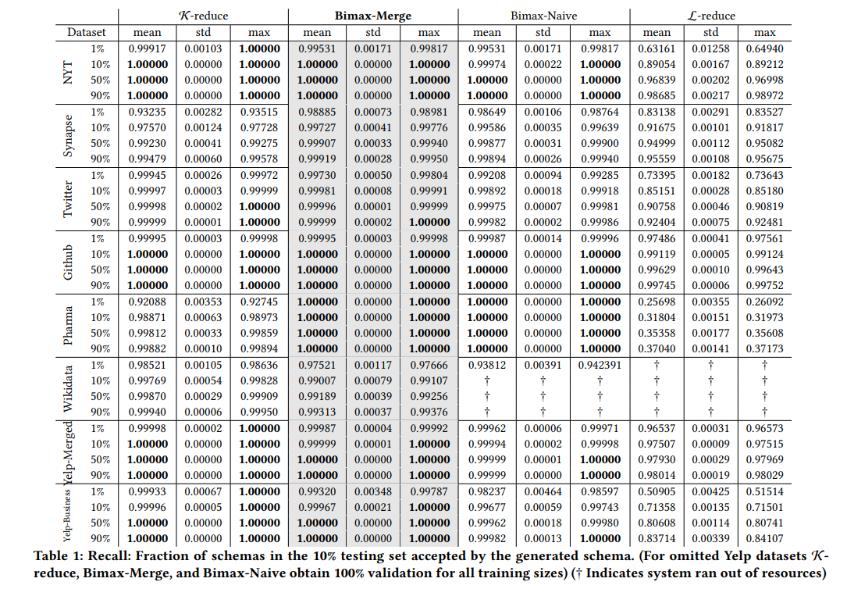
Results
In this paper, the author compared four different algorithms, which are
K - Reduce
Bimax Naive
Bimax Merge
L - Reduce

Slide 17
Critique & Conclusion
Critique:
When Json data goes beyond encoding gilded csv documents, Json's capabilities for tuple and collection layering makes maintaining schemas extremely challenging.
Conclusion:
Jxplain avoids two assumptions concerning the creation of Json records:
Which hierarchical structures encode nested collections, and
how many entities exist in a Json object collection (nested or not)
Jxplain adds many pre-processing rounds to conventional schema discovery to avoid these assumptions. Although these passes add a significant amount of cost to the extraction process, the resultant schemas are tighter and more compact, particularly for complicated Json data models, lowering the amount of human tweaking necessary to optimize them.

